Slide 1

DATA WAREHOUSING
AND
DATA MINING

Slide 2
"Data Warehouse"
The term "Data Warehouse" was first coined by Bill Inmon in 1990. According to Inmon, a data warehouse is a subject oriented, integrated, time-variant, and non-volatile collection of data. This data helps analysts to take informed decisions in an organization.

Slide 3
Evolution
60’s: Batch reports
  hard to find and analyze information
  inflexible and expensive, reprogram every new request
70’s: Terminal-based DSS and EIS (executive information systems)
  still inflexible, not integrated with desktop tools
80’s: Desktop data access and analysis tools
  query tools, spreadsheets, GUIs
  easier to use, but only access operational databases
90’s: Data warehousing with integrated OLAP engines and tools

Slide 4
Warehouses are Very Large Databases
35%
30%
25%
20%
15%
10%
5%
0%
Respondents
Initial
Projected 2Q96
Source: META Group, Inc.
5GB
10-19GB
50-99GB
250-499GB
5-9GB
20-49GB
100-249GB
500GB-1TB

Slide 5
Very Large Data Bases
Terabytes -- 10^12 bytes:
Petabytes -- 10^15 bytes:
Exabytes -- 10^18 bytes:
Zettabytes -- 10^21 bytes:
Zottabytes -- 10^24 bytes:
Walmart -- 24 Terabytes
Geographic Information Systems
National Medical Records
Weather images
Intelligence Agency Videos

Slide 6
Operational Systems
An operational database undergoes frequent changes on a daily basis on account of the transactions that take place. Suppose a business executive wants to analyze previous feedback on any data such as a product, a supplier, or any consumer data, then the executive will have no data available to analyze because the previous data has been updated due to transactions.

Slide 7

Operational Systems
Run the business in real time
Based on up-to-the-second data
Optimized to handle large numbers of simple read/write transactions
Optimized for fast response to predefined transactions
Used by people who deal with customers, products -- clerks, salespeople etc.
They are increasingly used by customers

Slide 8
Examples of Operational Data
Data
Industry
Usage
Technology
Volumes
Customer
All
Track
Legacy application, flat
Small-medium
File
Customer
files, main frames
Details
Account
Finance
Control
Legacy applications,
Large
Balance
account
hierarchical databases,
activities
mainframe
Point-of-
Retail
Generate
ERP, Client/Server,
Very Large
Sale data
bills, manage
relational databases
stock
Call
Telecomm-
Billing
Legacy application,
Very Large
Record
unications
hierarchical database,
mainframe
Production
Manufact-
Control
ERP,
Medium
Record
uring
Production
relational databases,
AS/400

Slide 9
Why a Data Warehouse is Separated from Operational Databases
A data warehouses is kept separate from operational databases due to the following reasons −
An operational database is constructed for well-known tasks and workloads such as searching particular records, indexing, etc. In contract, data warehouse queries are often complex and they present a general form of data.
Operational databases support concurrent processing of multiple transactions. Concurrency control and recovery mechanisms are required for operational databases to ensure robustness and consistency of the database.
An operational database query allows to read and modify operations, while an OLAP query needs only read only access of stored data.
An operational database maintains current data. On the other hand, a data warehouse maintains historical data.

Slide 10


So, what’s different?

Slide 11
Application-Orientation vs. Subject-Orientation
Application-Orientation
Subject-Orientation
Operational Database
Data
Warehouse
Credit
Card
Loans
Customer
Vendor
Product
Trust
Savings
Activity

Slide 12
A data warehouses provides us generalized and consolidated data in multidimensional view. Along with generalized and consolidated view of data, a data warehouses also provides us Online Analytical Processing (OLAP) tools. These tools help us in interactive and effective analysis of data in a multidimensional space. This analysis results in data generalization and data mining.

Slide 13
Data mining functions
Data mining functions such as association, clustering, classification, prediction can be integrated with OLAP operations to enhance the interactive mining of knowledge at multiple level of abstraction. That's why data warehouse has now become an important platform for data analysis and online analytical processing.

Slide 14
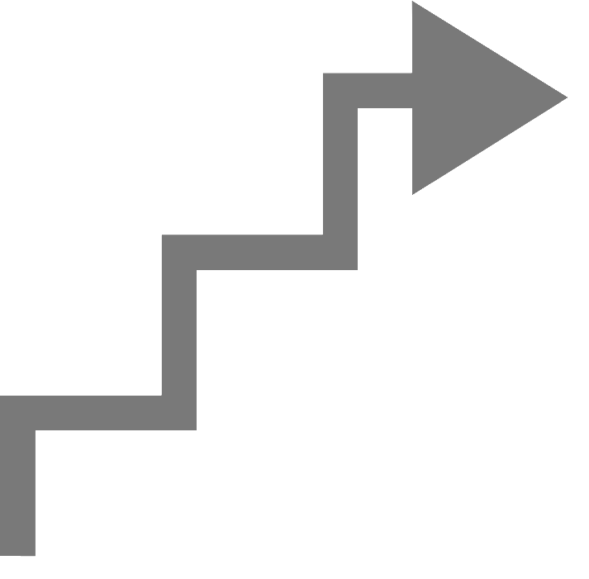
What is Data Warehousing?
A process of transforming data into information and making it available to users in a timely enough manner to make a difference
[Forrester Research, April 1996]
Information
Data

Slide 15

Data Warehousing --
It is a process
Technique for assembling and managing data from various sources for the purpose of answering business questions. Thus making decisions that were not previous possible
A decision support database maintained separately from the organization’s operational database

Slide 16
Data Warehouse
A data warehouse is a single, complete and consistent store of data obtained from a variety of different sources.
  subject-oriented
  integrated
  time-varying
  non-volatile
collection of data that is used primarily in organizational decision making.
  -- Bill Inmon, Building the Data Warehouse 1996

Slide 17
Data Warehouse Features
The key features of a data warehouse are discussed below −
Subject Oriented − A data warehouse is subject oriented because it provides information around a subject rather than the organization's ongoing operations. These subjects can be product, customers, suppliers, sales, revenue, etc. A data warehouse does not focus on the ongoing operations, rather it focuses on modelling and analysis of data for decision making.
Integrated − A data warehouse is constructed by integrating data from heterogeneous sources such as relational databases, flat files, etc. This integration enhances the effective analysis of data.
Time Variant − The data collected in a data warehouse is identified with a particular time period. The data in a data warehouse provides information from the historical point of view.
Non-volatile − Non-volatile means the previous data is not erased when new data is added to it. A data warehouse is kept separate from the operational database and therefore frequent changes in operational database is not reflected in the data warehouse.
Note − A data warehouse does not require transaction processing, recovery, and concurrency controls, because it is physically stored and separate from the operational database.

Slide 18
Data Warehouse Applications
As discussed before, a data warehouse helps business executives to organize, analyze, and use their data for decision making. A data warehouse serves as a sole part of a plan-execute-assess "closed-loop" feedback system for the enterprise management. Data warehouses are widely used in the following fields −
Financial services
Banking services
Consumer goods
Retail sectors
Controlled manufacturing

Slide 19
Types of Data Warehouse
Information Processing − A data warehouse allows to process the data stored in it. The data can be processed by means of querying, basic statistical analysis, reporting using crosstabs, tables, charts, or graphs.
Analytical Processing − A data warehouse supports analytical processing of the information stored in it. The data can be analyzed by means of basic OLAP operations, including slice-and-dice, drill down, drill up, and pivoting.
Data Mining − Data mining supports knowledge discovery by finding hidden patterns and associations, constructing analytical models, performing classification and prediction. These mining results can be presented using the visualization tools.

Slide 20
Understanding a Data Warehouse
A data warehouse is a database, which is kept separate from the organization's operational database.
There is no frequent updating done in a data warehouse.
It possesses consolidated historical data, which helps the organization to analyze its business.
A data warehouse helps executives to organize, understand, and use their data to take strategic decisions.
Data warehouse systems help in the integration of diversity of application systems.
A data warehouse system helps in consolidated historical data analysis.

Slide 21
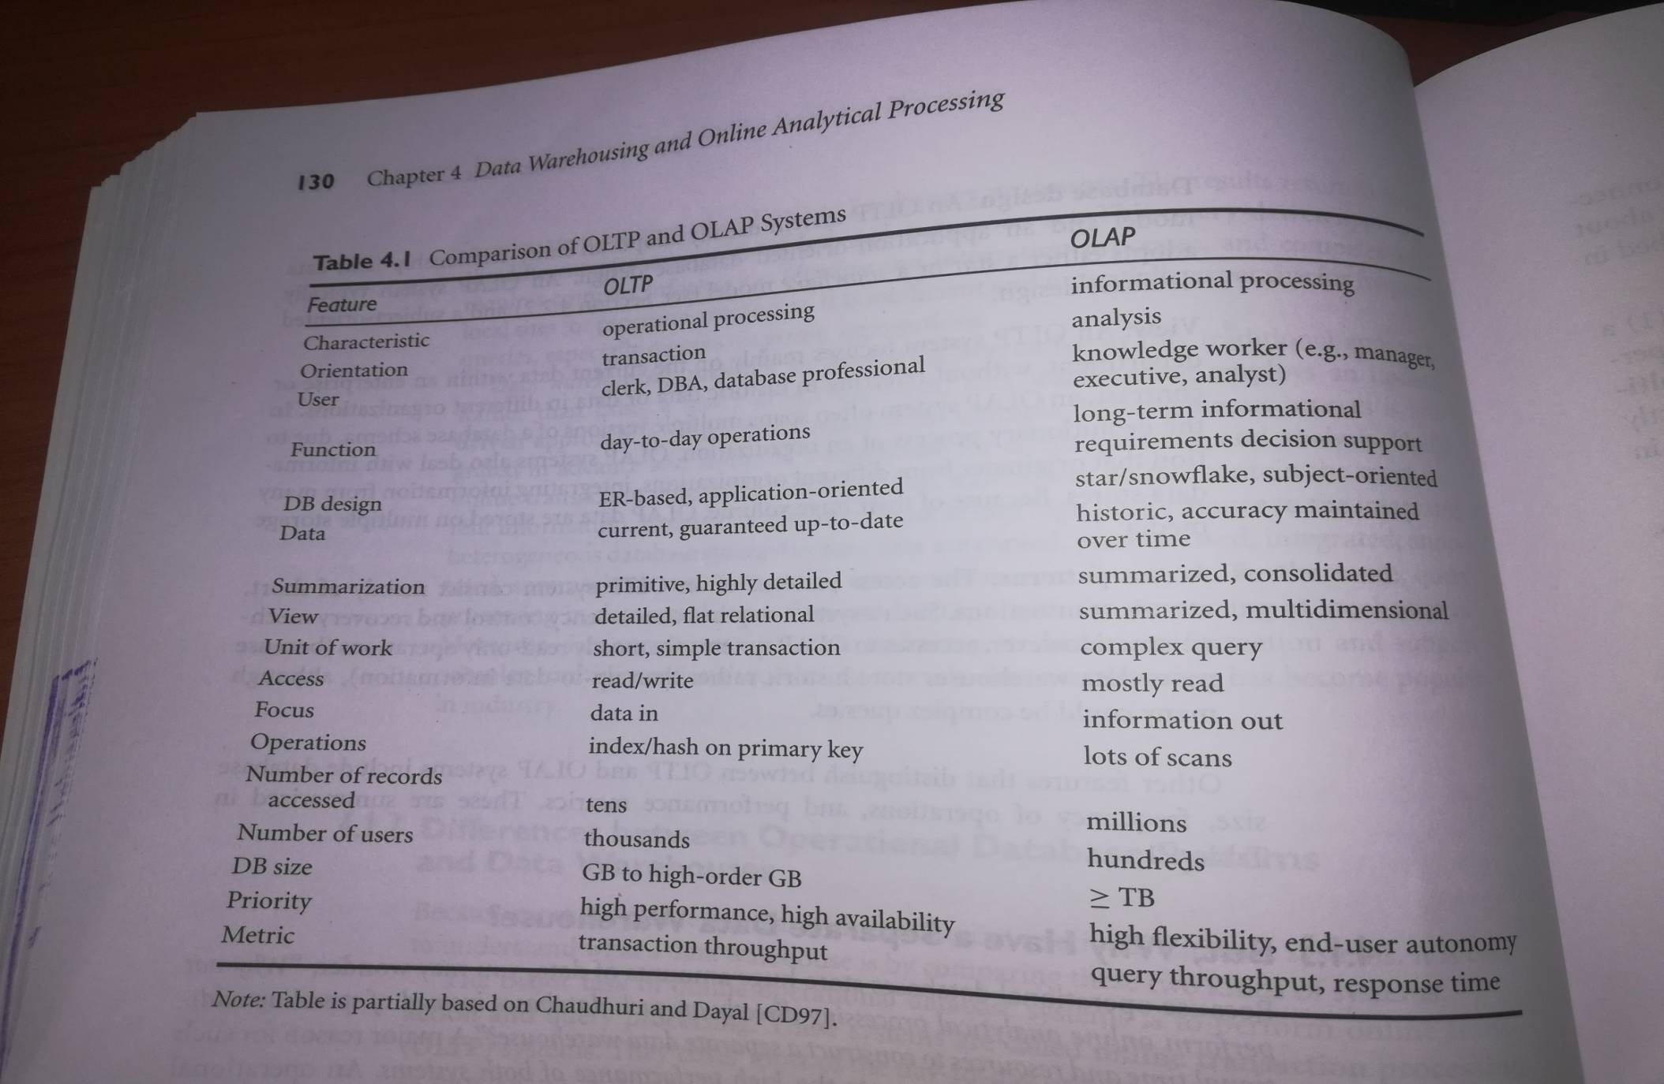
OLTP vs. Data Warehouse

Slide 22
OLTP vs Data Warehouse
OLTP
  Application Oriented
  Used to run business
  Detailed data
  Current up to date
  Isolated Data
  Repetitive access
  Clerical User
Warehouse (DSS)
  Subject Oriented
  Used to analyze business
  Summarized and refined
  Snapshot data
  Integrated Data
  Ad-hoc access
  Knowledge User (Manager)

Slide 23
OLTP vs Data Warehouse
OLTP
  Performance Sensitive
  Few Records accessed at a time (tens)
  Read/Update Access
  No data redundancy
  Database Size 100MB -100 GB
Data Warehouse
  Performance relaxed
  Large volumes accessed at a time(millions)
  Mostly Read (Batch Update)
  Redundancy present
  Database Size 100 GB - few terabytes

Slide 24
OLTP vs Data Warehouse
OLTP
  Transaction throughput is the performance metric
  Thousands of users
  Managed in entirety
Data Warehouse
  Query throughput is the performance metric
  Hundreds of users
  Managed by subsets

Slide 25


To summarize ...
OLTP Systems are
used to “run” a business
The Data Warehouse helps to “optimize” the business

Slide 26
Data Warehousing provides architectures and tools for business executives to systematically organize, understand, and use their data to make strategic decisions.

